Slide 1







IBM Data Science Capstone Project
German Fuentes
31/01/2024

Slide 2


OUTLINE
Executive Summary
Introduction
Methodology
Results
Conclusion
Appendix

Slide 3
EXECUTIVE SUMMARY
Methodologies:
Data Collection: Gathered relevant datasets for analysis.
Data Wrangling: Cleaned and processed raw data for quality.
EDA: Explored data patterns for insights.
Visual Analytics: Used interactive tools for data representation.
Predictive Analysis: Applied classification models for forecasting.
Results:
EDA Insights: Revealed data structure and key characteristics.
Geospatial Analytics: Mapped geographical patterns for enhanced understanding.
Interactive Dashboard: User-friendly interface for dynamic data exploration.
Predictive Classification: Models for informed decision-making.
The project successfully executed each step, providing actionable insights through data exploration, visualization, and predictive analysis.

Slide 4
INTRODUCTION
This project focuses on predicting the successful landing of the SpaceX Falcon 9 first stage, a pivotal factor in the company's cost-efficient rocket launches priced at $62 million.
The ability to forecast landing outcomes enables an estimation of launch costs, aiding in the assessment of competitiveness against other providers charging significantly higher prices. By deploying predictive analysis, decision-makers can strategically evaluate whether alternate companies should bid against SpaceX for rocket launches.
Ultimately, this initiative aims to enhance decision-making in the space industry, offering valuable insights for cost-effective and reliable launch options.

Slide 5
METHODOLOGY
Data Collection Approach aggregated data from the SpaceX public API and SpaceX Wikipedia page Conducted data wrangling procedures.
Categorized successful and unsuccessful landings through classification.
Executed exploratory data analysis (EDA) employing visualization techniques and SQL queries.
Implemented interactive visual analytics using Folium and Plotly Dash.
Conducted predictive analysis using classification models Optimized models through parameter tuning using GridSearchCV

Slide 6
DATA COLLECTION ANALYSIS
Engaged in data collection through a dual approach, utilizing API requests from SpaceX's public API and web scraping data from a table within SpaceX's Wikipedia entry.
SpaceX API Data Fields: FlightNumber, Date, BoosterVersion, PayloadMass, Orbit, LaunchSite, Outcome, Flights, GridFins, Reused, Legs, LandingPad, Block, ReusedCount, Serial, Longitude, Latitude Wikipedia Web Scraped Data Fields: Flight No., Launch site, Payload, PayloadMass, Orbit, Customer, Launch outcome, Version Booster, Booster landing, Date, Time.

Slide 7
Data Wrangling
Generate Training Labels: Established a training label based on landing outcomes, designating 'successful' as 1 and 'failure' as 0 within the 'Outcome' column, which comprises 'Mission Outcome' and 'Landing Location.' Introduced a new training label column named 'class,' assigning a value of 1 when 'Mission Outcome' is true, and 0 otherwise. Value mapping includes:
True ASDS, True RTLS, & True Ocean, set to 1
None None, False ASDS, None ASDS, False Ocean, False RTLS, set to 0

Slide 8
Exploratory Data Analysis (EDA)
Conducted EDA on key variables including Flight Number, Payload Mass, Launch Site, Orbit, Class, and Year. Utilized various plots for analysis, such as Flight Number vs. Payload Mass, Flight Number vs. Launch Site, Payload Mass vs. Launch Site, Orbit vs. Success Rate, Flight Number vs. Orbit, Payload vs. Orbit, and Success Yearly Trend.
Implemented scatter plots, line charts, and bar plots to discern relationships between variables, facilitating the identification of significant patterns for incorporation into the machine learning model training process.

Slide 9
Data Integration and Analysis
Imported the dataset into an IBM DB2 Database for efficient storage and retrieval. Utilized SQL Python integration to execute queries, extracting valuable insights to enhance understanding of the dataset.
Formulated queries to retrieve information on launch site names, mission outcomes, payload sizes of customers, booster versions, and landing outcomes. This approach facilitated a comprehensive exploration of the dataset, aiding in the extraction of pertinent details for further analysis and decision-making.

Slide 10
Folium Mapping Analysis
Implemented Folium maps to visually represent Launch Sites, successful and unsuccessful landings, along with proximity markers for key locations: Railway, Highway, Coast, and City.
This visualization strategy provides insights onto the rationale behind the selection of launch site locations, offering a comprehensive understanding of their proximity to crucial infrastructure.
The mapping also effectively illustrates the distribution of successful landings in relation to geographical features, enhancing the interpretation of spatial patterns and informing future launch site decisions.

Slide 11
Dashboard Overview
Incorporated a dynamic dashboard featuring a pie chart and a scatter plot to enhance data visualization.
The pie chart allows users to toggle between displaying the distribution of successful landings across all launch sites and exploring individual launch site success rates.
The scatter plot is designed with two inputs: the option to view data for all sites or an individual site, and a payload mass slider ranging from 0 to 10000 kg.
The pie chart serves as an intuitive tool for visualizing launch site success rates, while the scatter plot offers insights into the variability of success across launch sites, payload masses, and booster version categories. This interactive dashboard facilitates a comprehensive exploration of key factors influencing successful landings.

Slide 12
Predictive Analysis
Split label column
Score models on
Confusion Matrix
‘Class’ from dataset
split test set
for all models
Fit and Transform
Use GridSearchCV
Features using
on LogReg, SVM,
Barplot to compare scores of models
Standard Scaler
Decision Tree, and
KNN models
Train_test_split
GridSearchCV
data
(cv=10) to find optimal parameters

Slide 13
Results
Exploratory Data Analysis
Interactive Analysis
Predictive Analysis (Classification)
Providing a sneak peek into the upcoming Plotly dashboard, the subsequent slides will showcase the results of Exploratory Data Analysis (EDA) with visualizations, EDA utilizing SQL, an Interactive Map with Folium, and culminate with the presentation of our model results, boasting an impressive accuracy rate of approximately 83%.
These sections collectively illustrate the comprehensive journey from data exploration to predictive modeling, highlighting key insights gained and the successful application of analytical methodologies throughout the project.

Slide 14
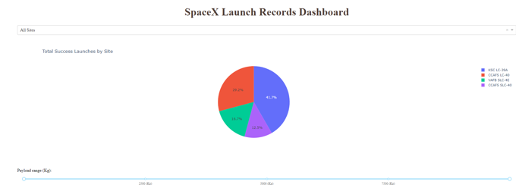
Results

Slide 15
EDA - WITH VISUALIZATION

Slide 16
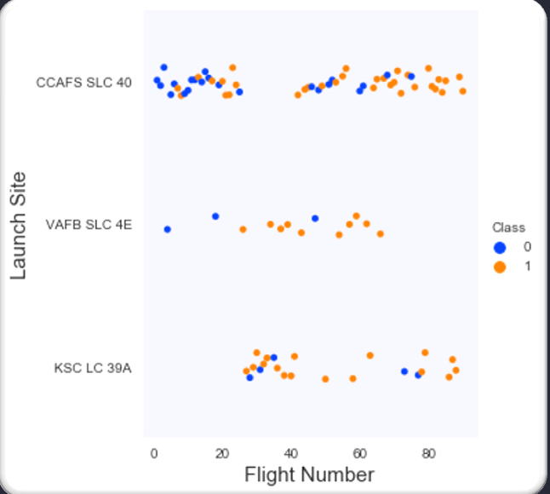
Flight Number vs. Launch Site

Slide 17
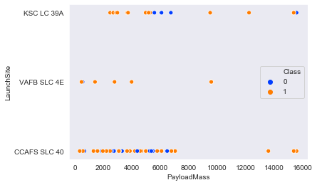
Payload vs. Launch Site

Slide 18
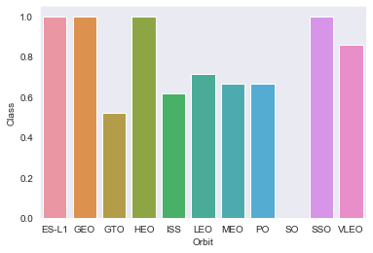
Success rate vs. Orbit type

Slide 19
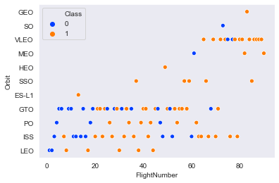
Flight Number vs. Orbit type

Slide 20
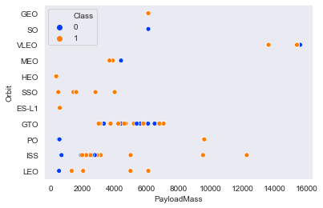
Payload vs. Orbit type

Slide 21
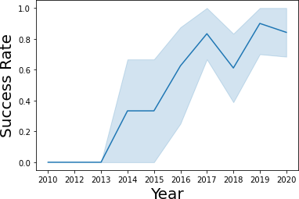
Launch Success Yearly Trend

Slide 22
EDA - WITH SQL

Slide 23
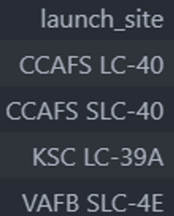
All Launch Site Names

Slide 24
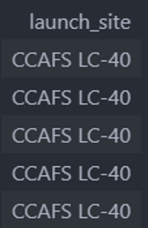
Launch Site Names Begin with 'CCA'

Slide 25

Total Payload Mass from NASA

Slide 26

Average Payload Mass by F9 v1.1

Slide 27
First Successful Ground Pad Landing Date

Slide 28
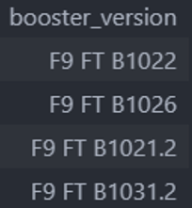
Successful Drone Ship Landing with Payload Between 4000 and 6000
List the names of boosters which have successfully landed on drone ship and had payload mass greater than 4000 but less than 6000.

Slide 29
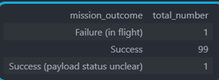
Total Number of Each Mission Outcome

Slide 30
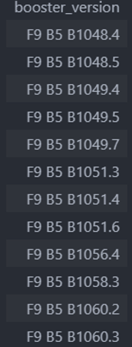
Boosters that Carried Maximum Payload

Slide 31

2015 Failed Drone Ship Landing Records

Slide 32
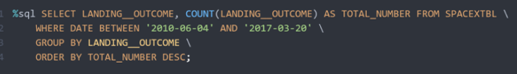
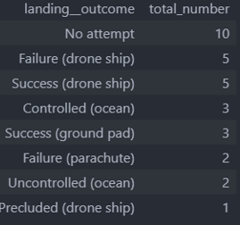
Rank Landing Outcomes Between 2010-06-04 and 2017-03-20

Slide 33
Interactive Map with Folium

Slide 34
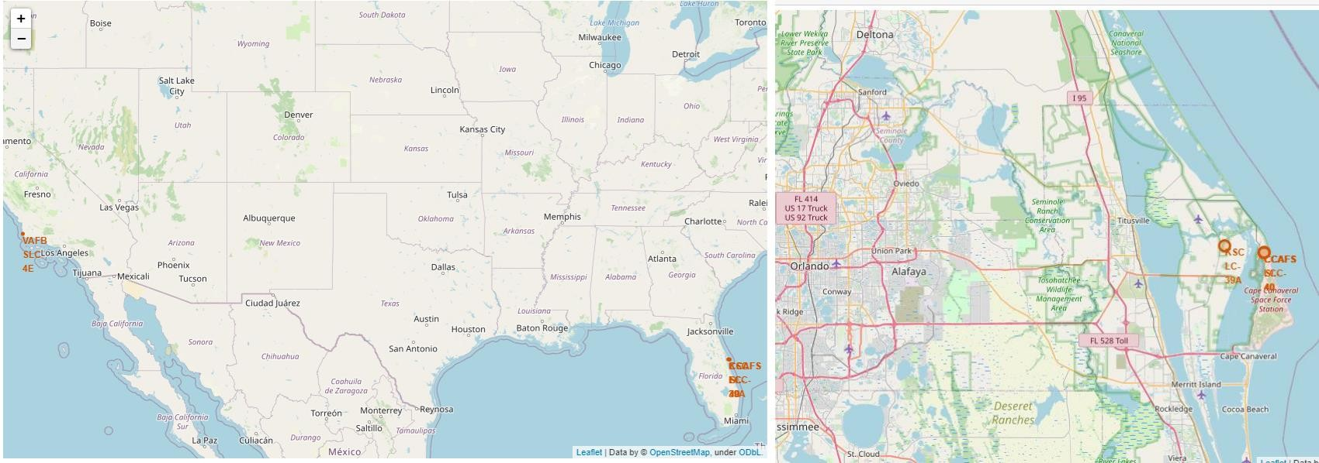
Launch Site Locations

Slide 35
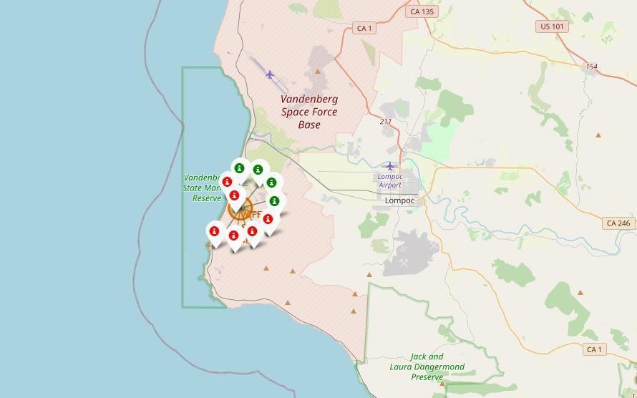
Color-Coded Launch Markers

Slide 36
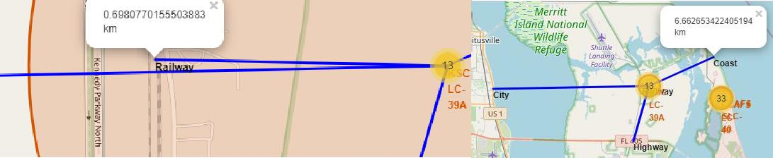
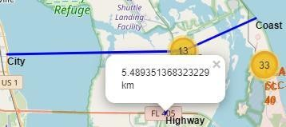
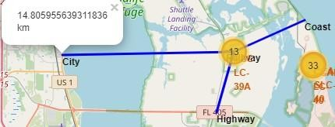
Key Location Proximities

Slide 37
Interactive dashboard Plotly Dash

Slide 38
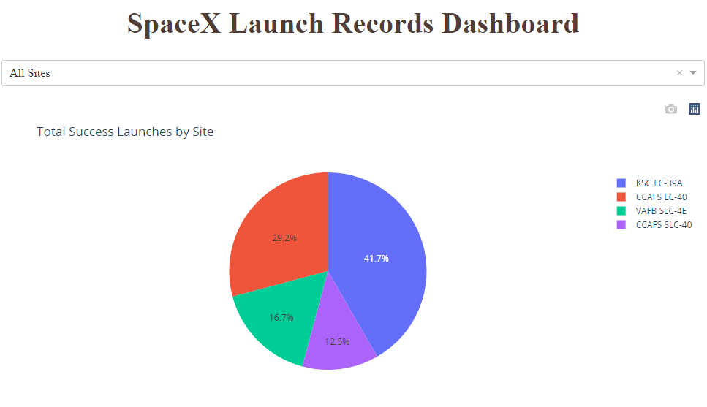
Launch success count for all sites

Slide 39
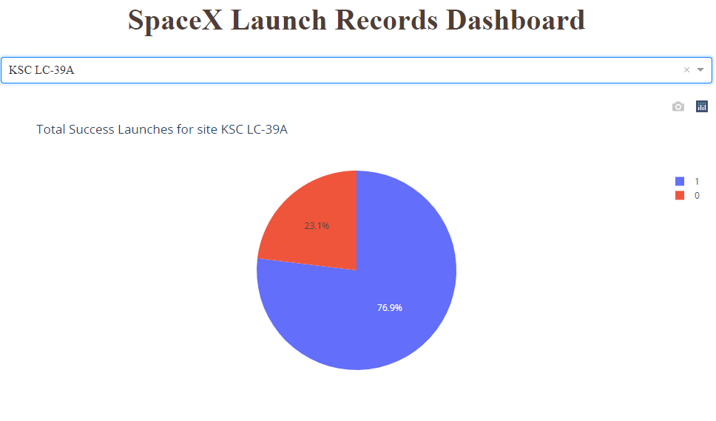
Pie chart for the launch site with highest launch success ratio

Slide 40
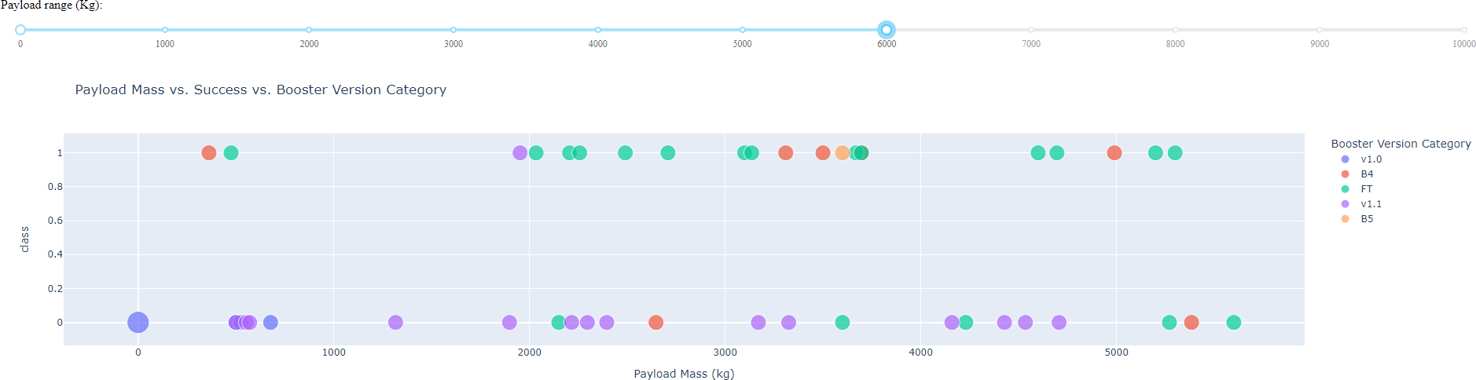
Payload Mass vs. Success vs. Booster Version Category

Slide 41
Predictive Analysis (Classification)

Slide 42
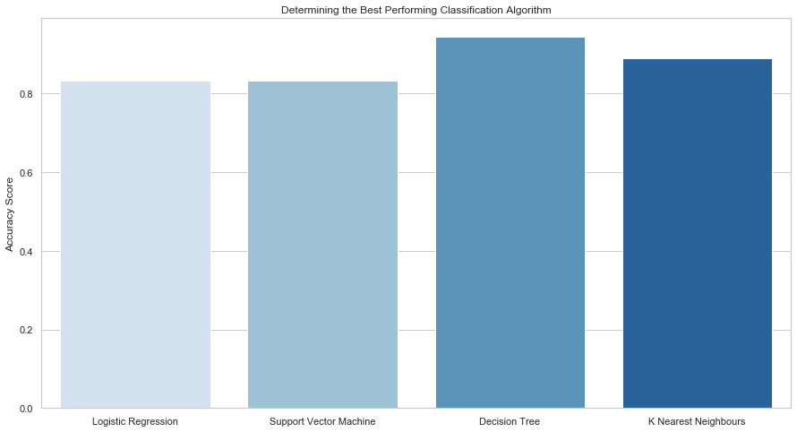
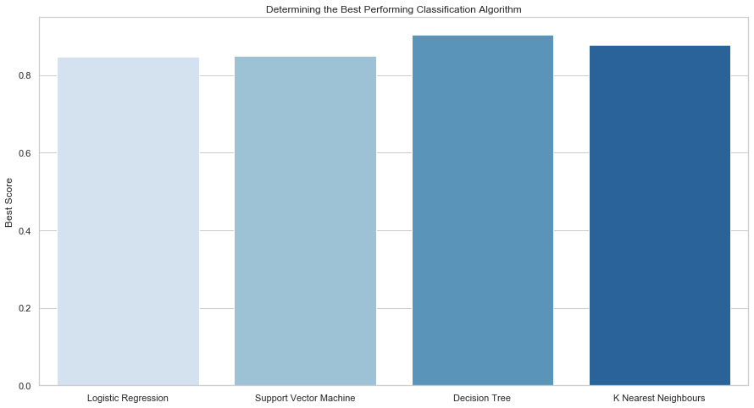
CLASSIFICATION ACCURACY
Plotting the Accuracy Score and Best Score for each classification algorithm produces the following result:
The Decision Tree model has the highest classification accuracy
The Accuracy Score is 94.44%
The Best Score is 90.36%

Slide 43
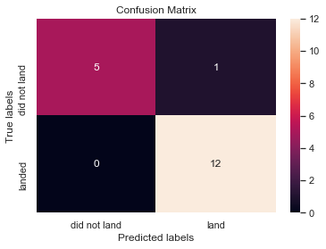
Confusion Matrix
As shown previously, best performing classification model is the Decision Tree model, with an accuracy of 94.44%.
This is explained by the confusion matrix, which shows only 1 out of 18 total results classified incorrectly (a false positive, shown in the top-right corner).
The other 17 results are correctly classified (5 did not land, 12 did land).

Slide 44
Conclusion
Our mission is to develop a machine learning model for SpaceY, enabling informed bidding against SpaceX by predicting successful Stage 1 landings and potentially saving around $100 million USD per launch. Utilizing data from both a public SpaceX API and web scraping the SpaceX Wikipedia page, we curated data labels and stored the information in a DB2 SQL database. The resulting dashboard offers insightful visualizations.
Model Development:
Successfully created a machine learning model achieving an accuracy of 83%, providing a reliable tool for SpaceY to predict the success of Stage 1 landings before launch. This predictive capability is crucial for decision-making, allowing SpaceY to assess whether a launch should proceed.
Future Enhancements:
To further optimize the model and improve accuracy, it is recommended to collect additional data. This continuous data collection will facilitate the identification of the best machine learning model, ensuring SpaceY possesses a robust tool for accurate predictions and strategic decision-making in the competitive space launch industry.

Slide 45
Appendix
Github Link: https://github.com/ShogunGerman/Module-10-

